Slide 1

Taiwan’s Election and Democratization Study (TEDS):
Retrospect and Prospects
Chi Huang
Coordinator & PI

Slide 2
TEDS in Retrospect
2001-2016

Slide 3

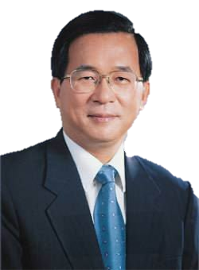
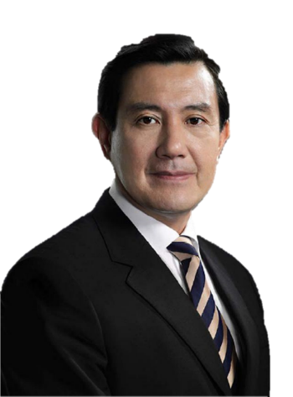


締
造臺灣第三次政黨輪替民主奇蹟的頭家，是臺灣選民。
而見證「臺灣選民」意見、態度與投票行為的民意調查
計畫，則是「台灣選舉與民主化調查」！
（Taiwan’s Election and Democratization Study, TEDS）
About TEDS:
自2001年開創以來，以15波面訪、21波電訪、15波網調，忠實記錄了臺灣民主波濤洶湧的選舉歷程，不僅匯聚成彌足珍貴的本土實證史料，且十五年來創造了930篇以上的中英文學術著作，躋身美國密西根大學ICPSR政治與社會科學研究資料庫（ICPSR 35094）。
2000
1st power transition
2008
2nd
2016
3rd
TEDS faithfully recorded Taiwan’s road to democracy!

Slide 4
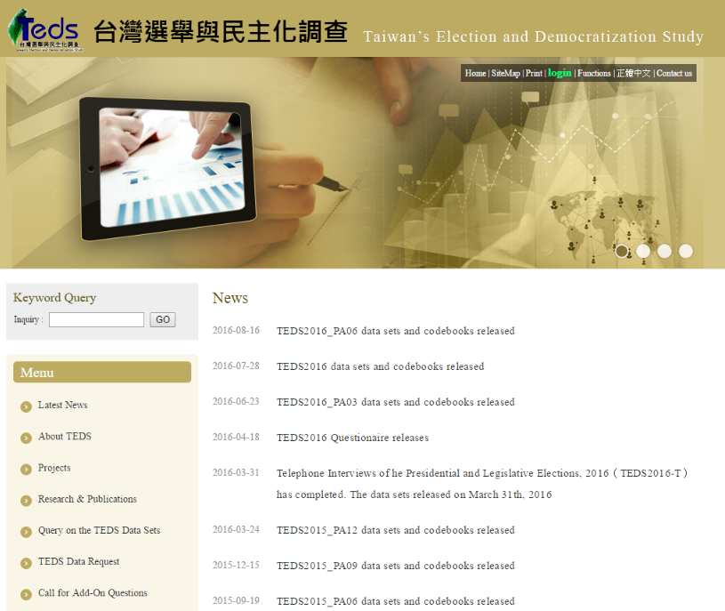
TEDS’s Website: http://teds.nccu.edu.tw/main.php

Slide 5

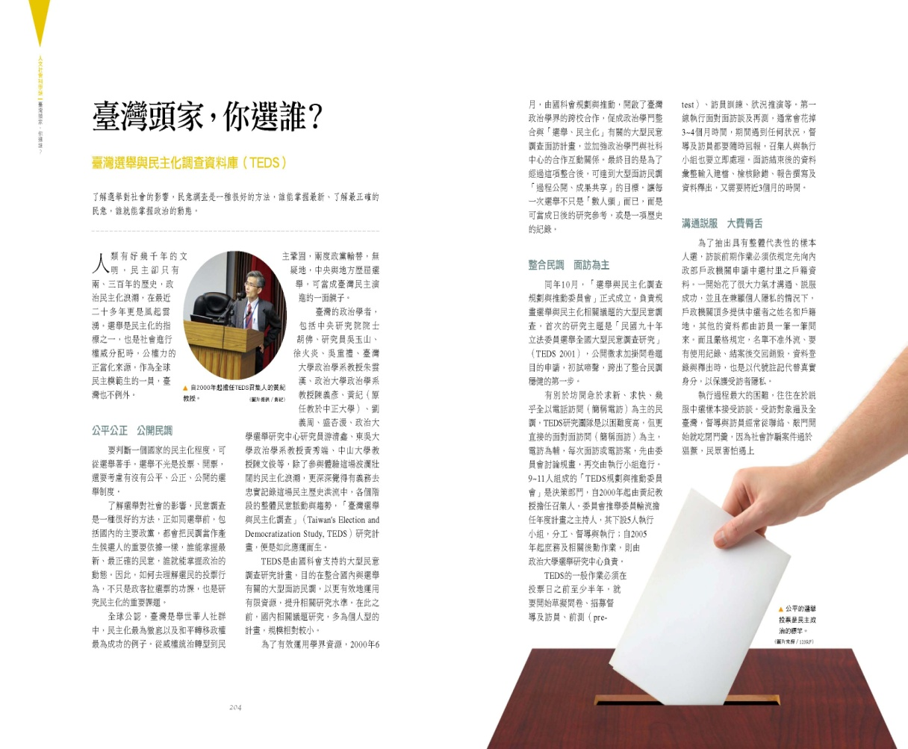
Origin and Vision
Because the TEDS data have been widely acknowledged and cited by the research community, the TEDS was chosen in 2008 as one of the BEST 50 projects for the past 50 years.
5

Slide 6
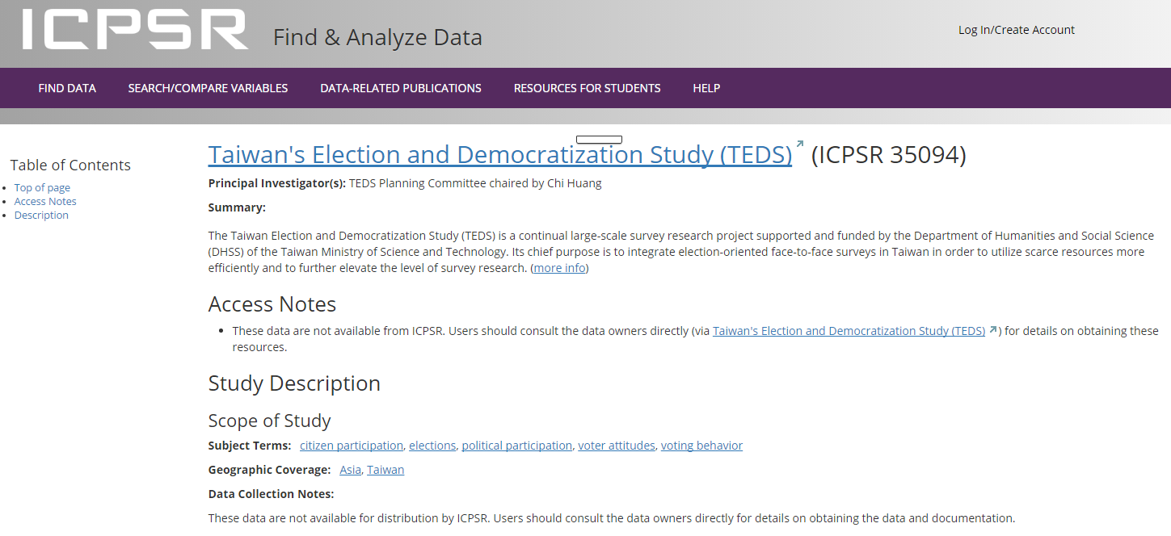
TEDS collected by ICPSR
University of Michigan included TEDS in the ICPSR database (ICPSR 35094).

Slide 7
The TEDS Archive: 2001-2016
TEDS survey data archive includes:
15 Face-to-face surveys
23 telephone interview surveys
16 internet surveys
5 focus groups interviews

Slide 8
Completed interviews
15 Face-to-face surveys
TEDS2001 | The Survey of Legislative Election in 2001
TEDS2002 | The Survey of Taipei City/ Kaohsiung City Mayoral Election in 2002
TEDS2003 | The Survey of Taiwan's Election and Democratization Study in 2003
TEDS2004P | The Survey of Presidential Election in 2004
TEDS2004L | The Survey of Legislative Election in 2004
TEDS2005M | The Survey of County Magistrate/City Mayoral Elections in 2005
TEDS2006C | The Survey of Taipei City/ Kaohsiung City Mayoral Election in 2006

Slide 9
Completed interviews
15 Face-to-face surveys
TEDS2008L | The Survey of Legislative Election in 2008
TEDS2008P | The Survey of Presidential Election in 2008
TEDS2009M | The Survey of County Magistrate Elections in 2009
TEDS2010C | The Survey of Cities Mayoral Elections of Taipei, Taichung, and Kaohsiung Cities in 2010
TEDS2012 | The Survey of the Presidential and Legislative Elections in 2012
TEDS2013 | 2013 Benchmark Survey
TEDS2014 | The Survey of Local Elections (Cities, Counties, Townships, and Villages, the “9 in 1”) in 2014
TEDS2016 | The Survey of the Presidential and Legislative Elections in 2016

Slide 10
Completed interviews
23 Telephone interviews
TEDS2005NA | The Survey of National Assembly Election in 2005
TEDS2008L-T | The Survey of Taipei City/Kaohsiung City Mayoral Election in 2002
TEDS2009L_BE-T | Legislative By-Elections: Telephone Interview
TEDS2012-T | Telephone Interview of the Presidential and Legislative Elections
TEDS2012-T_PA09 | Telephone Interview of the Presidential Approvals—First
TEDS2012-T_PA12 | Telephone Interview of the Presidential Approvals—Second
TEDS2013-T_PA03 | Telephone Interview of the Presidential Approvals—Third
TEDS2013-T_PA06 | Telephone Interview of the Presidential Approvals—Fourth
TEDS2013-T_PA09 | Telephone Interview of the Presidential Approvals—Fifth
TEDS2013-T_PA12 | Telephone Interview of the Presidential Approvals—Sixth

Slide 11
Completed interviews
23 Telephone interviews
TEDS2014-T | The Survey of Local Level Election (the “9 in 1”) in 2014
TEDS2014-T_PA03 | Telephone Interview of the Presidential Approvals—Seventh
TEDS2014-T_PA06 | Telephone Interview of the Presidential Approvals—Eighth
TEDS2014-T_PA09 | Telephone Interview of the Presidential Approvals—Ninth
TEDS2014-T_PA12 | Telephone Interview of the Presidential Approvals—Tenth
TEDS2015-T_PA03 | Telephone Interview of the Presidential Approvals—Eleventh
TEDS2015-T_PA06 | Telephone Interview of the Presidential Approvals—Twelfth
TEDS2015-T_PA09 | Telephone Interview of the Presidential Approvals—Thirteenth
TEDS2015-T_PA12 | Telephone Interview of the Presidential Approvals—Fourteenth

Slide 12
Completed interviews
23 Telephone interviews
TEDS2016-T | Telephone Interview of the Presidential and Legislative Elections
TEDS2016-T_PA03 | Telephone Interview of the Presidential Approvals—Fifteenth
TEDS2016-T_PA06 | Telephone Interview of the Presidential Approvals—Sixteenth
TEDS2016-T_PA09 | Telephone Interview of the Presidential Approvals—Seventeenth
New!

Slide 13
Completed interviews
5 Focus Group Interviews
TEDS2008L-F | Legislative Elections: Focus Groups
TEDS2013-F | The Presidential Approvals: Focus Groups
TEDS2014-F | The Presidential Approvals: Focus Groups
TEDS2015-F | The Presidential Approvals: Focus Groups
TEDS2016-F | The Presidential Approvals & Presidential Election: Focus Groups

Slide 14
Completed interviews
15 TEDS international conferences
2002.10.19-20 | the International Conference on Taiwan’s Election and Democratization Study 2001
2003.11.01-02 | the International Conference on Taiwan’s Election and Democratization Study 2003
2004.09.25-26 | the International Conference on Taiwan’s Election and Democratization Study 2004
2005.03.26-27 | TEDS Workshop
2005.05.21-22 | the International Conference on Taiwan’s Election and Democratization Study(TEDS 2004P)
2005.11.12-13 | the International Conference on Taiwan’s Election and Democratization Study 2005: Cross-national Survey Studies
2006.10.21 | the International Conference on Taiwan’s Election and Democratization Study 2006
2007.10.20-21 | the International Conference on Taiwan’s Election and Democratization Study 2007

Slide 15
Completed interviews
15 TEDS international conferences
2009.01.17-18 | the International Conference on Taiwan’s Election and Democratization Study 2008
2009.05.22-23 | the International Conference on Taiwan’s Election and Democratization Study 2009
2010.10.30 | 2010 International Conference on Taiwan’s Election and Democratization Study: Local Elections and Local Governance
2011.12.03-04 | 2011 International Conference on Taiwan’s Election and Democratization Study: Cities Mayoral Elections
2012.11.03-04 | An International Conference on The Maturing of Taiwan Democracy: Findings and Insights from the 2012 TEDS Survey
2014.03.22-23 | 2014 International Conference on Taiwan’s Election and Democratization Study: Local Elections and Local Governance
2016.10.30 | 2016 International Conference on Taiwan’s Election and Democratization Study
We are Here!

Slide 16
Impact of TEDS
Research and Publications Cited the TEDS Data: 971 items in total
Articles published in Taiwanese journals: 167 Articles published in international journals: 91 Books published (in Chinese): 1 Books published (in English): 1 Book chapters (in Chinese): 30 Book chapters (in English): 31 Papers presented in domestic conferences: 123 Papers presented in international conferences: 376 Master theses and Ph.D. dissertations (in Taiwan): 143 Master theses and Ph.D. dissertations (abroad): 8

Slide 17


Slide 18
Figure 1 President Ma’s Approval Rates: Sep. 2012 to Mar. 2016
Source: Huang (2016).

Slide 19
Figure 2 President Tsai’s Approval Rates: Jun. 2016 – Sep. 2016
Source: Huang et al (2016).

Slide 20
Achievements of TEDS in the Past 16 Years
Set the template of publicly released high-quality survey data in Taiwan. Train the next-generation empirical political scientists. Employ/Develop efficient high-tech methods of surveys, such as e-CAPI for FTF surveys and cellular-phone interfaces for internet surveys.

Slide 21
TEDS’ New Challenges in 2016-2020:
Upgrade to TEDS 2.0

Slide 22
TEDS 2.0: the New TEDS 2016-2020 Project
The TEDS team oaths to maintain the great tradition to “open the participation channels to the academic community and share the collected data sets with the public.”
The new four-year project not only maintains the tradition of TEDS established in the past sixteen years but also breaks new grounds for further development. We are literally upgrading from TEDS 1.16 to a brave new TEDS 2.0!

Slide 23
Challenges to TEDS 2016-2020
Telephone Survey: Rising proportion of cell-only population
Face-to-Face Survey: Barriers to accessing the sampling frame, i.e. the government Household Registration Archive
Internet Survey: Weak representativeness of volunteer sample

Slide 24
Challenge 1: rising % of cell-only population
Strategy 1: dual-frame telephone interviews
Quarterly telephone surveys on the topics of presidential approval rate will continue, although they are now based on dual-frame random digit dialing (RDD) designs covering both landline and mobile phones. An innovative weighting scheme will be developed to merge the data from landline and cell-only phone surveys. A TEDS dual-frame RDD workshop is scheduled on November 12, 2016.

Slide 25
Challenge 2: barrier to FTF sampling frame
Strategy 2: GIS-based address+within-household sampling scheme
To overcome the bureaucratic barrier to accessing the Household Registration Archive, the TEDS team will design a brand new address-based sampling (ABS) scheme based on a comprehensive database archived in geographical information system (GIS) so that voters with local household registration can be sampled and interviewed face-to-face. A 4-member task force is now busy working on this new GIS-ABS design. It will be tested during the summer of 2017.

Slide 26
TEDS 2.0: the New TEDS 2016-2020 Project
Two waves of face-to-face interviews based on the new GIS-ABS design are planned－TEDS 2018 & 2020:
TEDS 2018 is the face-to-face survey in three metropolitan cities after the 2018 local elections of city mayors/county magistrates and councilors.

Slide 27
TEDS 2.0: the New TEDS 2016-2020 Project
TEDS 2020 is the nation-wide post-election survey targeting the 2020 presidential and legislative elections, assuming that both elections will be held concurrently as in 2012 and 2016. If the two elections were to be held separately, however, a supplementary proposal will be submitted to MOST for funding a separate FTF survey for the 2020 presidential election.

Slide 28
Challenge 3: maximize internet survey utility
Strategy 3: TEDS internet survey experiments
An innovative platform for computer-assisted internet survey experiments will be developed to take advantage of the speed and relatively low cost of internet surveys. Once the hardware and software are tested ready in 2017, an open call for randomized internet survey experiment proposals will be issued each semester. Proposals related to improving questionnaire designs and causal inferences will be reviewed by the TEDS Planning Committee for approval and implementation.

Slide 29

Thank you!
  Your support to the TEDS project is deeply appreciated!
  Please feel free to let us, the TEDS team, know your comments and suggestions.

